Slide 1

DB Design fine tuning Part1: Functional Dependency
CS3083-B Prof. Arfaoui

Slide 2
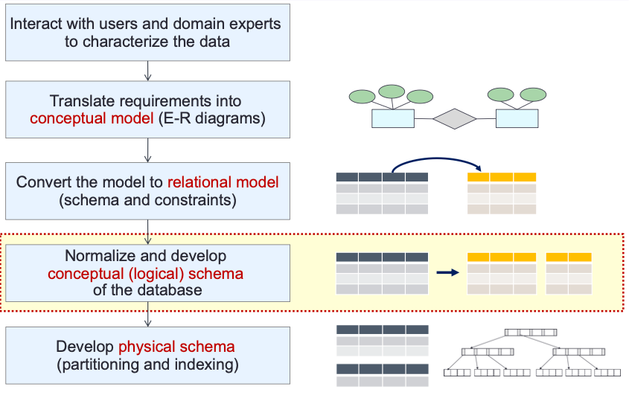
Database Design Process

Slide 3
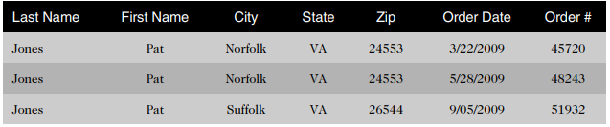
Motivating Example
“Why not just put all the data in one big table?”
This single-table approach leads to problems of:
data redundancy (duplication)
data anomalies (data inconsistencies).
The customer information is repeated for each order a customer places (redundancy).
The city data in the last row is different from the first two rows (data anomaly).
Notes:
Many people unfamiliar with database design principles often ask, “Why not just put all the data in one big table?” This single-table approach leads to problems of data redundancy (duplication) and data anomalies (data inconsistencies). For example, review the order data recorded in Table 1-1. The customer information is repeated for each order a customer places (redundancy). Also, the city data in the last row is different from the first two rows. Under these circumstances, it isn’t clear whether the last row actually represents a different customer, whether the previous customer had an address change, or whether the city information is incorrect (data anomaly).

Slide 4
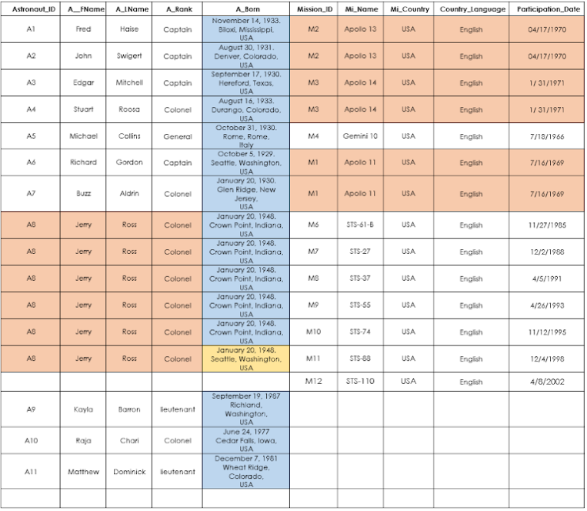
un-normalized database
The following database is an example of poor database design.
At first glance, it is obvious that the table shows many redundancies.
In addition, the values ​​in the born column contain multivalued data.
This is called an un-normalized database.
The main disadvantage of an un-normalized database is the increase in memory demand due to redundant values.
In addition, attributes that contain multivalued data are difficult to read and retrieve.

Slide 5
Problem: Redundancy
Redundancy: storing the same data in different places can cause problems when updates or changes to data are required
Data redundancy leads to semantic anomalies which, in turn, make automatic data processing and database maintenance difficult.
Redundancy results in inefficient use of memory and data anomalies. Any data that is redundant in the database is an error waiting to happen.

Slide 6
Database anomalies
INSERTION ANOMALY: occurs when the insertion of certain data necessitates the presence of other data.
UPDATE ANOMALY: occurs when performing an update to a record. If data is stored redundantly in the same table, and the update misses any of them, then there will be data inconsistency.
DELETION ANOMALY: occurs when the deletion of a certain data (undesired) causes other data (desired) to be deleted as well.

Slide 7
INSERTION ANOMALY
Suppose for a new mission, until and unless an astronaut opts for a mission, mission’s data cannot be inserted, or else astronaut’s data will be set as NULL (see Row 14).
Also, if we want to insert data for 10 astronauts who took parts of the same mission, then the same mission data will be repeated 10 times (see Rows 1 and 2).
An astronaut who has not taken part of a mission cannot have his data inserted, or else mission data will be left NULL (see the last three rows).

Slide 8
Update ANOMALY
For instance, Jerry Ross’s data is redundant and is listed six times.
If we were to change Jerry Ross’s rank due to a promotion, updating one record and missing the other ones will result in multiple ranks associated with Jerry Ross.
It becomes difficult later to determine the correct information.

Slide 9
Delete ANOMALY
For example, the deletion of Michael Collins data, who is the sole astronaut of Gemini10, causes the deletion of data concerning this mission.

Slide 10
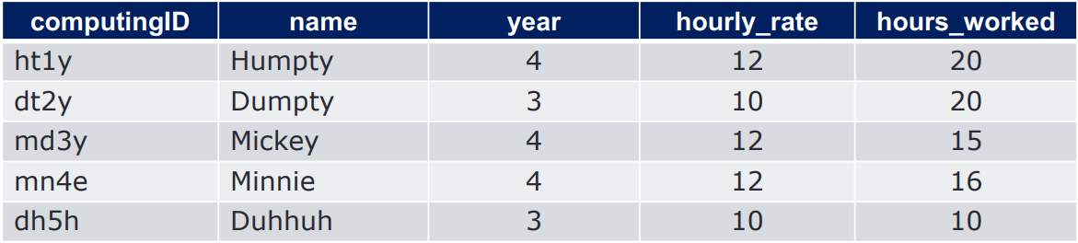
DB anomalies Example 2
Consider info about TAs
Associate year with the hourly_rate
The hourly_rate of Humpty can be derived from the hourly_rate of Mickey (or Minnie) since they are all 4th year and we know year determines hourly_rate.
Redundancy exists because of the existence of integrity constraints, in particular Functional Dependencies (FD). [More functional dependencies later]

Slide 11
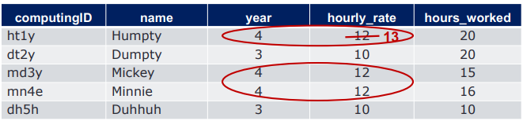
TA Info: Update Anomaly
What if we attempt to update hourly_rate of Humpty?
Only one copy of hourly_rate has been updated
Hourly_rate determined by year=4 appears in multiple tuples in the table.
Cannot change hourly_rate in just the 1st tuple

Slide 12
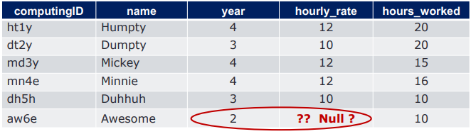
TA Info: INSERT Anomaly
What if we want to insert a new employee, who is in 2nd year, but we don’t know the hourly rate for the 2nd year?
Cannot insert a new employee into the table

Slide 13
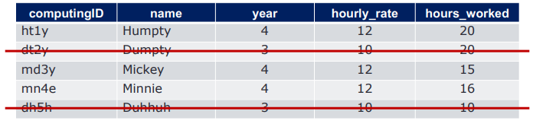
TA Info: Delete Anomaly
What if we delete all employees who are in 3rd year?
Lose information about the hourly_rate for 3rd year

Slide 14
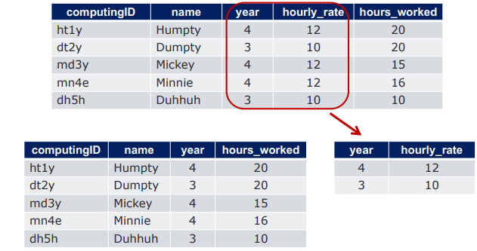
TA Info: Potential Solution
Decompose the relation, separate unrelated attributes
Functional Dependencies – to the rescue!!

Slide 15
Normalization is the Solution
Normalization is the process of efficiently organizing data in a database.
It is a multistep strategy implemented to eliminate data redundancy and protect the integrity of relational databases.
It often results in dividing a table into several and connecting them to each other by primary and foreign keys.
The goal is to isolate data so that manipulating (adding, deleting or modifying) data across a column can be done in a single table, and propagates to the rest of the database through relationships.
It also ensures data dependencies and the logical storage of data.

Slide 16
normalized database
A database is normalized if it is at least in 3rd normal form.
The normalization process is composed of the following normal forms:
First Normal Form (1NF)
Second Normal Form (2NF)
Third Normal Form (3NF)
Additional: Boyce-Codd normal form (BCNF)

Slide 17
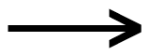
FUNCTIONAL DEPENDENCY
A functional dependency is a description of a relationship between two attributes, typically between the PK and other non-key attributes within a table.
Let X and Y be two sets of attributes. There is a functional dependency between X and Y when, knowing the value of X, we determine one and only one value for Y.
We represent the functional dependency by X Y where:
X: (the left part) is called the determinant of the FD (also known as source)
Y: (the right part) is called the determined of the FD (also known as the dependent, goal, or target).

Slide 18
FD - Examples
Student_ID, Course_Number → Enrollement_Date
Student_ID and Course_Number determine the Enrollement_Date.
Given a unique combination Student_ID and Course_Number, we can determine one single for Enrollement_Date.
Astronaut_ID → A_Rank
Astronaut_ID determines A_Rank.
Astronaut_ID is the determinant.
A_Rank is the determined.
This means that an Astronaut_ID only corresponds to one and only one Rank.

Slide 19
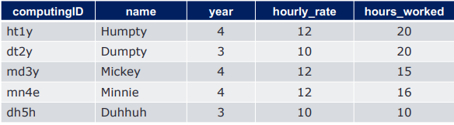
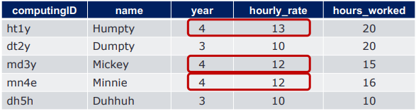
FD more Examples
year → houtly_rate holds
year → houtly_rate does not hold

Slide 20
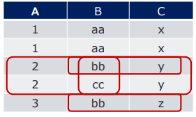
Let’s Try: FDs
Which of the following is functional dependency?
A → B
B → C
AB → C
A → C
C → B
Possible
Not enough information
(cannot prove non-existence of violation)

Slide 21
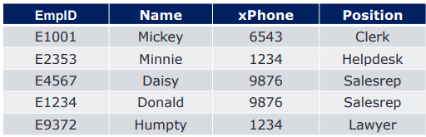
Let’s Try: FDs (2)
List all the possible FDs
EmpID → Name, xPhone, Position

Slide 22

Let’s Try: FDs (2)
Do all the following FDs hold on this instance?
ProductName → Color
Category → Department
Color, Category → Price
Possible
Does not hold
If we can be sure that every instance of R will be one in which a given FD is true, then we say that R satisfies the FD
If we say that R satisfies an FD, we are stating a constraint on R

Slide 23
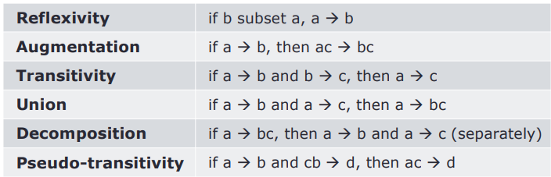
Reasoning about FDs
To use FDs to break a relation, focus on a key and list all possible FDs
Given some FDs, infer additional FDs using the following inference axioms :
There are many rules that let us infer that one FD X → A holds in any relation instance that satisfies some other given set of FDs. To verify that X → A holds, compute the closure of X, using the given FDs to expand X until it includes A

Slide 24
Example: Reasoning
Supposed we know:
custID → name
Can we conclude the following?
custID, hair_color → name
YES!
Adding more attributes to the antecedent can never remove attributes in the consequent

Slide 25
Example: Reasoning (2)
Supposed we know:
custID → name
Can we conclude the following?
custID → name, hair_color
NO!
Impossible to introduce hair_color to the consequent without also introducing it to the antecedent

Slide 26
Example: Attribute Closure
Attribute Closure (X+) = all FDs a particular X attribute can imply
Closure of F (F+) = a set of all FDs that are implied by F
An FD f is logically implied by a set of FDs F if f holds whenever all FDs in F hold.
To compute the closure of a set of functional dependencies F
F+ = F
repeat
for each functional dependency f in F+
apply reflexivity and augmentation rules on f
add the resulting functional dependencies to F+
for each pair of functional dependencies f1 and f2 in F+
if f1 and f2 can be combined using transitivity
then add the resulting functional dependency to F+
until F+ does not change any further

Slide 27
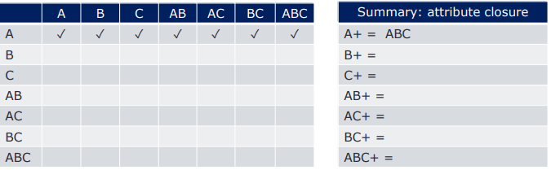
Example: Attribute Closure
Given R(A,B,C)
FDs = {A → B, B → C }
Compute the attribute closures for all attribute and combination of attributes. Then, think about what can be inferred.

Slide 28
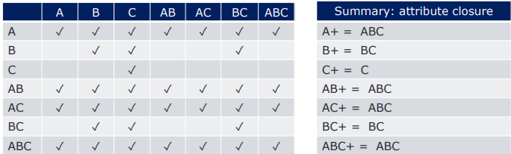
Example: Attribute Closure
Given R(A,B,C)
FDs = {A → B, B → C }
Compute the attribute closures for all attribute and combination of attributes. Then, think about what can be inferred.

Slide 29
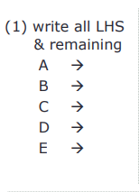
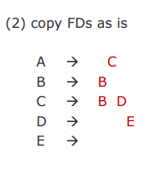
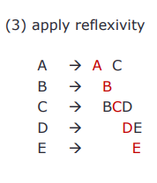
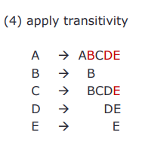
Example1: Computing F+
Given R(A,B,C,D,E)
FDs = { A → C, B → B, C → BD, D → E }
Compute F+

Slide 30
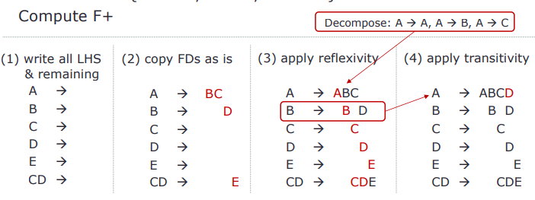
Example2: Computing F+
Given R(A,B,C,D,E)
FDs = {A -> BC, B -> D, CD -> E }
Compute F+

Slide 31
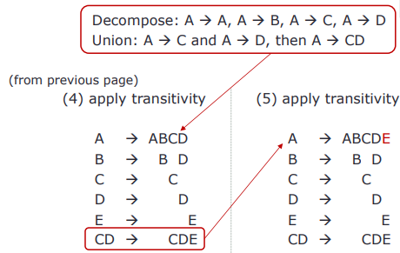
Example2: Computing F+ (cont.)

Slide 32
Next Time:
Normalization
Fine-tuning part 2: figure out the fundamentals of what makes good database schemas and how to organize the data (i.e., refine the schemas) to promote ease of use and efficiency

